Slide 1


Technical Presentation

Slide 2
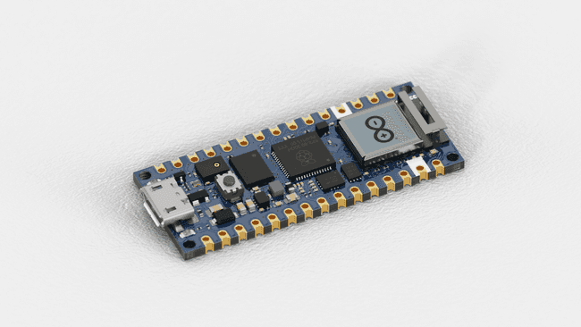
Microcontroller
The Arduino® Nano RP2040 Connect is a development board in Nano format, based on the RP2040 microcontroller. It features a Wi-Fi / Bluetooth® module, a 6-axis IMU (Inertial Measurement Unit) with machine learning capabilities, a microphone and a built-in RGB.

Slide 3
Microcontroller
Raspberry Pi RP2040 Microcontroller
133MHz 32bit Dual Core Arm® Cortex®-M0+
264kB on-chip SRAM
Direct Memory Access (DMA) controller
Support for up to 16MB of off-chip Flash memory via dedicated QSPI bus
4 channel ADC with internal temperature sensor, 0.5 MSa/s, 12-bit conversion
40nm process node
Multiple low power mode support
USB 1.1 Host/Device
Internal Voltage Regulator to supply the core voltage

Slide 4
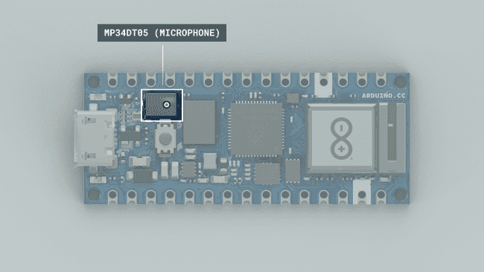
Microphone
The MP34DT06JTR is a compact, low-power omnidirectional digital MEMS (microelectromechanical system) microphone with an IC interface. It has a 64 dB signal-to-noise ratio, is capable of sensing acoustic waves and can operate in temperatures of -40 °C to +85 °C.

Slide 5
Microphone
ST Microelectronics MP34DT06JTR
Acoustic Overload Point = 122.5 dBSPL
64 dB signal-to-noise ratio
Omnidirectional sensitivity
-26 dBFS ± 1 dB sensitivity
ECOPACK, RoHS and Green compliant

Slide 6
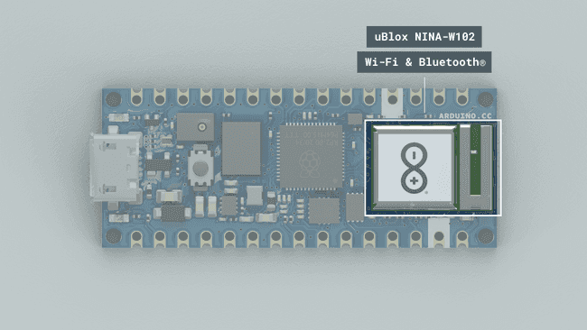
Connectivity
The Nano RP2040 Connect supports both Wi-Fi and Bluetooth® Low Energy through the uBlox W-102 module. The NINA-W10 series are stand-alone multiradio MCU modules that integrate a powerful
Microcontroller and a radio for wireless communication. The module
has a number of important security features embedded, including secure boot, which ensures the
module boots up only in the presence of authenticated software.

Slide 7
Connectivity
uBlox NINA-W102
240MHz 32bit Dual Core Xtensa LX6
520kB on-chip SRAM
448 Kbyte ROM for booting and core functions
16 Mbit FLASH for code storage including hardware encryption to protect programs and data
1 kbit EFUSE (non- erasable memory) for MAC addresses, module configuration, Flash-Encryption, and
Chip-ID
IEEE 802.11b/g/n single-band 2.4 GHz Wi-Fi operation
Bluetooth® 4.2

Slide 8



Edge Impulse
Edge Impulse is a platform designed for developing machine learning models specifically tailored for edge devices, such as microcontrollers and low-power IoT (Internet of Things) devices. Data acquisition, processing and model training is done on the cloud then is deployed to each board for real time data processing.
Over 100 samples collected with 4 possible outputs:

Slide 9
Edge Impulse
Audio processing block: Extracts a spectrogram from audio signals using Mel-filterbank energy features, great for non-voice audio.

Slide 10
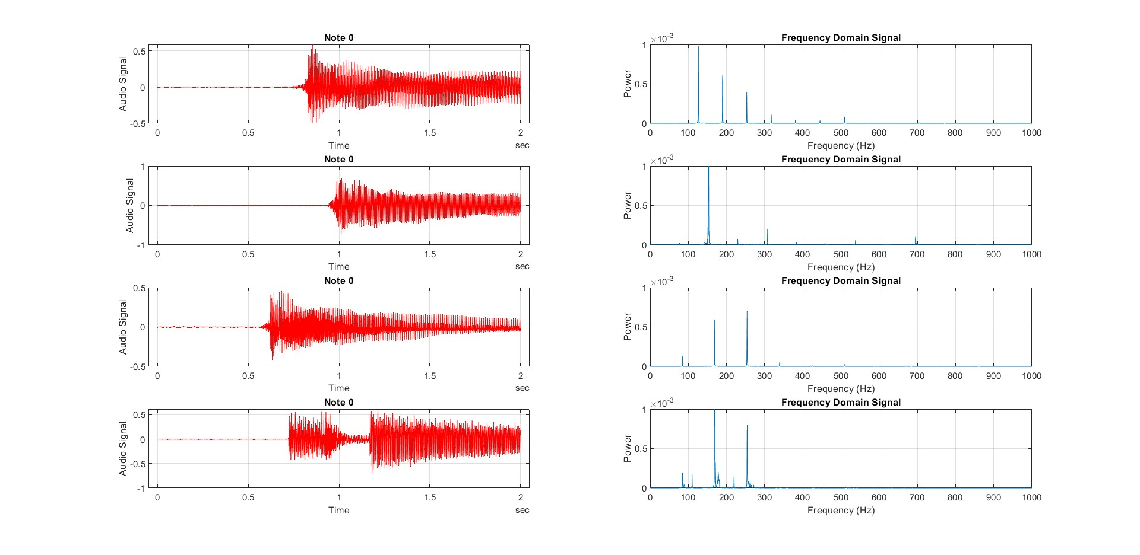
Signal processing in MATLAB

Slide 11
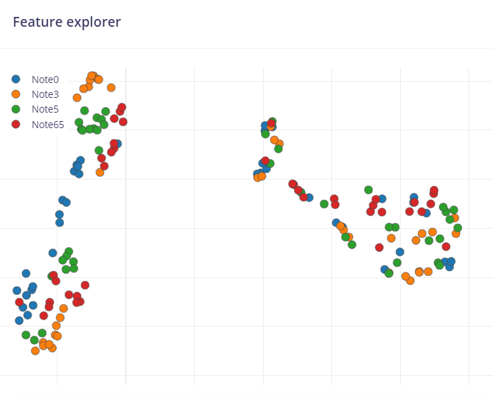
Mel-filterbank energy features

Slide 12
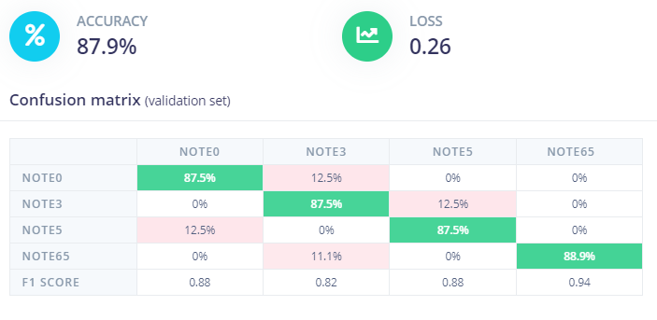
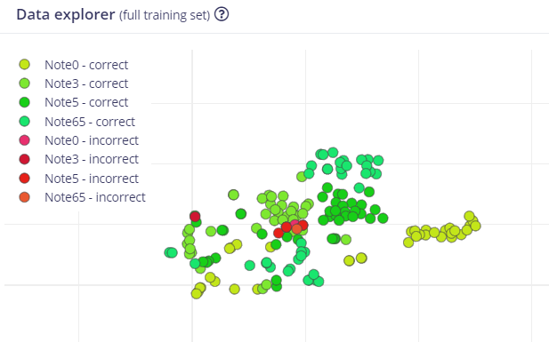
Model performance

Slide 13

Project deployment
The model is finally deployed as an Arduino Library (C++) that runs perfect on our microcontroller. The development board is programmed in the Arduino IDE.

Slide 14
CAD / 3D Printing
The prototypes are made out of basic PLA filament, printed on the BambuLab A1 mini with a 0.4 mm nozzle.
All parts are designed in Fusion 360.

